Slide 1
Competition, barriers to entry and inclusive growth, retail banking sector: Capitec case study
2nd Annual Competition and Economic Regulation week in Southern Africa.
Nicholas Nhundu & Trudi Makhaya
11 March 2016

Slide 2
Background & Methodology
Capitec bank- a relatively new successful entrant, effective competitor.
Capitec story
Explore benefits of entry
Will illuminate how the bank was able to pursue the opportunities available in this concentrated and highly regulated sector
Finally, it will consider whether there are ways in which the barriers which Capitec has had to overcome could be reduced for future entrants.
Methodology – interview based – Banks, Regulators, Associations, Research institutions.
Secondary research included review of annual reports & industry research

Slide 3
Benefits of entry: Prices of bank accounts – 2010 - 2014

Slide 4
Estimating customer savings in retail banking
Clients who stayed with the incumbent banks but enjoyed low prices due to competition – R1.5 billion per month.
Based on number of clients who stayed at each bank multiplied by the price decrease between 2010 and 2014 for the respective bank.
Clients who switched to Capitec from other banks – R 87.8 million.
75% of Capitec’s new clients between 2010 and 2014 are switchers from incumbents.
Calculated using the weighted average price for all incumbents.
Total annual savings ((87.8 million + 1.5 billion) *12) = 19.6 billion / US$ 93.7 million.
Financial inclusion – Capitec’s prominence in the low income segment sparked a competitive reaction from the incumbents.
From 2011 FNB’s Easy Account and Absa’s Transact account started to competing with Capitec.
Focus on the lower end of the market improved and consequently the number of the “never banked” in South Africa decreased by 18% between 2011 and 2014 (Finmark, 2015).

Slide 5
Main barriers to entry

Slide 6
Customer switching
South African retail banking industry is dominated by four big banks that constitutes 80% of the market share.
Customers reluctant to switch to small unknown brands.
Conduct of incumbents - complexity of fees and lack of price transparency (Banking enquiry, 2008).
Costs and inconvenience of switching is relatively high
Capitec benefited from a diversified business model and a good business strategy
Established through the acquisition of micro finance businesses.
Converting lending customers into banking clients.
Emphasis on simple and transparent product during the time when incumbents clients were not sure how their bank charges were determined.
Banking enquiry 2008 levelled the playing field and gave them a competitive edge.
Difficult to establish direct links - the general sentiment is that the partial application of the recommendations facilitated easy switching amongst clients.

Slide 7
Access to Financing
Retail banking require high initial investments.
IT systems; a branch and ATM network; brand-building expenditures
Most of these outlays are sunk investments that cannot be recovered in case of failure.
Capitec growth stagnated between 2001 & 2007 and took off in 2008
Struggled to raise external funding; relied mostly on internal sources
Investors are generally sceptic of small companies & debt markets inaccessible and expensive.
PSG a shareholder of reference – provided the bulk of equity financing during the difficult period.
Capitec had cash cow from the onset – lending business – able to expand into transactional banking using internal resources.

Slide 8
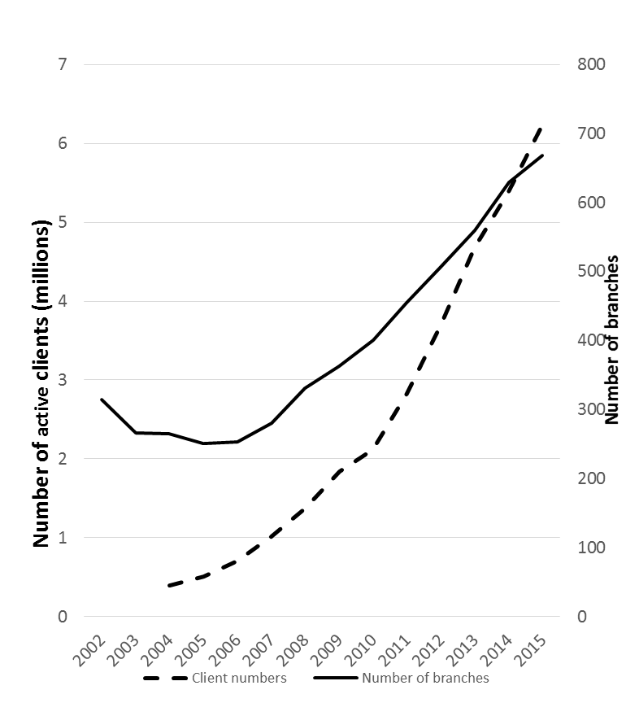
Number of branches and clients

Slide 9
Access, participation and governance in the payment system
Capitec’s entry into the payments system was smooth.
Ability to introduce innovation depends on all players being ready to move - a consequence of inter-operability
Capitec was the first to issue a debit MasterCard (as opposed to a Maestro card) which came with a dual messaging system.
Capitec had to wait for the other banks to be able to acquire the card - there was a significant delay in roll-out.
Small banks identified the cost of compliance with regulatory changes in the payments system as a key challenge.
Some of these changes are justified but prove to be a disproportionate burden on smaller banks.
Rigorous evaluation of the costs versus benefits of new regulation is needed?
Lenient legislation for small banks? - No significant exposure to the system given their size

Slide 10
Rolling out ATM network
ATM network significant factor in the market for deposits
Customer often decide who to bank with based on the ATM network of a bank.
However ATMs are expensive to set up and run.
Costs of transporting cash in South Africa
Opportunity costs of cash
Capitec – ATM network experiences
Customer behaviour – “cash convertors” with limited need for ATM network.
Capitec rolled out ATMs outside branches – well-placed, next to commuter routes.
“

Slide 11
Regulation
Banking license
Concern on the length of the licencing process.
Uncertainty affecting the licence requirements and outcomes.
Capitec converted an existing business banking license to a retail banking license - a process described as fair.
There are noticeable costs that came with meeting the capital adequacy ratios (Basel III)
the additional share capital issued to meet the capital adequacy diluted the return on equity from 34% to 23% from 2011 to 2014.
Cost of funding increased in the short term while the lending activities of the entity were reduced as a more conservative approach to credit provision was adopted.
Introduction of national credit act (2007)
Expansion of credit terms – usury exemptions fell away (max R10 000 payable 36 months)
Broadened market opened funding channels.

Slide 12
Implications for future entrants
Are there ways in which the barriers which Capitec has had to overcome could be reduced for future entrants?
Improve the switching process
Instituting a regulated switching process with mandatory timelines.
consider a process where consumers are not liable for interest, penalty fees and other charges incurred due to delays in switching bank accounts (Hawthorne 2014).
Sharing of FICA information, with clear guidelines on where liability lies in the case of contraventions (the original or second bank).
The possibility to move away from traditional banking model? (license, branches)
Technology and business model innovations have expanded the range of institutions that can offer transactional banking services beyond traditional banks.
Tiered banking model – class of banks facing lower regulatory requirements but with the ability to participate as full settlement members in the payments system.

Slide 13
`
Back up slides

Slide 14
Estimating customer savings in retail banking I – work in progress
Lower prices at big four banks
Bank | Number of clients 2014 | Price decrease (2010 - 2014) | Total savings
ABSA | 8 600 000,00 | R 91,00 | R 782 600 000,00
FNB | 7 600 000,00 | R 16,00 | R 121 600 000,00
Nedbank | 6 700 000,00 | R 9,00 | R 60 300 000,00
Standard Bank | 10 400 000,00 | R 56,00 | R 582 400 000,00
 |  |  | R 1 546 900 000,00
Notes:
Assumptions – all new clients at Capitec from 2010 are switchers from big four banks

Slide 15
Estimating customer savings in retail banking II
Even lower prices for those moving to Capitec from big four banks
Weighted average price - big four banks (2010 - 2014) | R 89,46
Average Capitec price 2010 - 2014 | R 53,60
Difference | R 35,86
Number of clients who switched (75% of new Capitec clients) | 2 449 500,00
Monthly savings for clients who switched | R 87 843 969,00
75% new clients at Capitec from 2010 are switchers from big four banks
Total savings
Total monthly savings (switchers plus non switchers) | R 1 664 025 292,00
Total Yearly savings (x12) | R 19 616 927 628,00
Notes:
Assumptions – all new clients at Capitec from 2010 are switchers from big four banks

