Slide 1


2nd ANNUAL COMPETITION AND ECONOMIC REGULATION (ACER) WEEK, SOUTHERN AFRICA
Competition in Supermarkets: A South African perspective
Reena das Nair
March 2016

Slide 2
Introduction
Rapid growth and spread of supermarkets into southern Africa in past 15 -20 years
Reasons:
Increased regional and international FDI
Increasing urbanisation & per capita income; rise of the middle class; lower unit costs due to economies of scale and scope; transport economies etc.
Better infrastructure; construction of shopping malls
Paper evaluates:
Nature and extent of barriers to entry caused by the very characteristics of supermarkets
Competition issues arising from the strategic behaviour of incumbents
Impact on independent retailers and on suppliers in SA
Key questions:
Do scale economies mean that only a few large supermarket chains can effectively operate in a given market?
How important then is competition from niche retailers and small entrants?
Is there a role for competition policy?
Notes:
Mainly SA supermarket chains, but this trend is changing

Slide 3
General trends
Main SA players Shoprite, PnP, SPAR, Woolworths, Fruit and Veg City) also operate in s. African countries
Entrants in grocery retail: FVC, Walmart (Massmart: Game,
Cambridge etc.); Botswana-owned Choppies (1st significant non-SA, multinational chain)
Most supermarkets target customers across full range of incomes:
moving into low-income and rural areas (Shoprite’s Usave; Pick n Pay’s Boxer; SPAR’s SaveMor)
raised concerns for independent supermarkets/retailers
SA supermarkets have diversified formats:
hypermarkets, convenience stores, express stores at fuel forecourts, fast food offerings etc.
Most have both corporate and franchise models
Notes:
Although some are converting franchised into corporate: FVC, Woolies

Slide 4
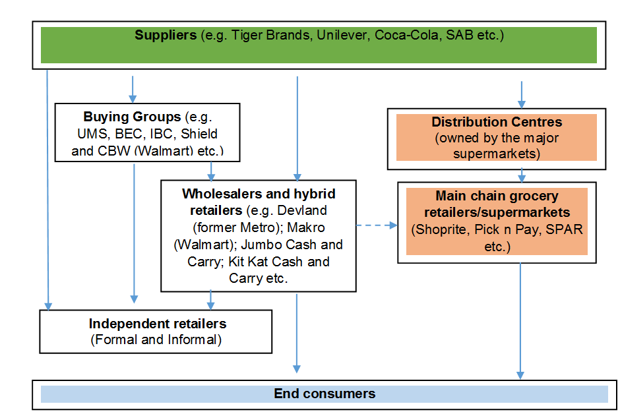
Typical supply chain of grocery products
Source: Adapted from Ravhugoni and Ngobese (2010); Masscash/Finro Tribunal decision Case No: 04/LM/Jan09

Slide 5
Characteristics of supermarkets and associated barriers to entry
Supermarkets have unique features:
supply universal daily food products, including perishable food items; various non-food items and services
offer ‘one-stop’ shop and overall shopping experience in a single physical location, located near work or home
large economies of scale and scope
tend to invest heavily in logistics, distribution centres & networks, inventory maintenance, advertising
bring in valuable footfall to shopping malls making them key anchor tenants
Unique features result in barriers to entry
Often means only a few large players - abuse of dominance & coordinated conduct concerns arise

Slide 6
Structural barriers to entry
Large investments in DCs - important for supermarkets with multiple stores
Up to 15% of total capex per year (Shoprite)
Cheaper for stores to buy from DCs
Economies of scale and scope
All majors and Choppies have invested significantly in DCs
Substantial advertising and promotions costs
 | Capital expenditure
SHOPRITE | Dec-13 | Dec-14 | Jun-15
 | ZAR m
Distribution centre | 137 | 228 | 280
DC- related equipment and vehicles | 91 | 181 | 375
PICK N PAY | 2010 (ZAR m)
Distribution centre | 628 (Longmeadow); total investment estimated at ZAR 2bill
Challenges for small players:
Sustainable business models/plans
Effective cash flow management

Slide 7
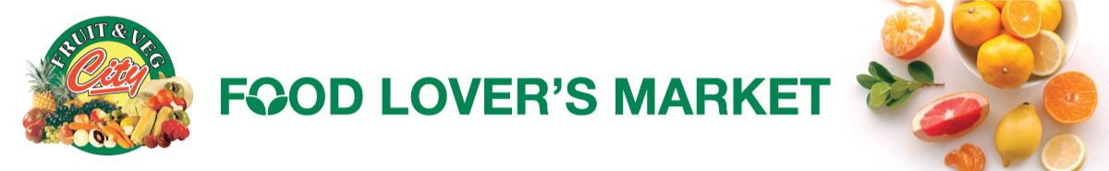
How important is competition from small entrants and niche retailers?
Started with single store in 1993 in Cape Town; identified gap in market for fresh fruit & veg stores only
In 2007, competition authorities prohibited merger with PnP; removal of effective competitor
FVC grew faster than other retailers at over 20% p.a. compared to av. of 15%
Expanded rapidly, has over 100 stores throughout s. Africa
Direct spot purchases mainly from municipal markets & some direct from farmers; keen cost containment and waste management
prices of fresh fruit & veg 20%- 25% lower than other supermarkets
Flexible business model- moved into different formats (Food Lovers Market); convenience Fresh Stop through Caltex JV, fast food chain, exports
Notes:
Growth rates of the major listed supermarket chains were reported at about 15% per year between 2006 and 2012, while that of FVC was 20% per year. http://www.financialmail.co.za/business/2012/07/18/fruit-veg-city-grows-market-share, accessed 15/01/2015.
Stores in CPT and JHB : wanted them to be corporate
1st store in Bruma Lake: hugely profitable

Slide 8

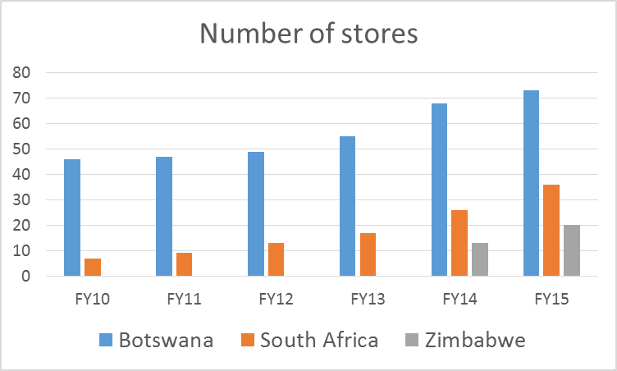
New kid on the s. African block: Choppies Enterprises
Grown to 129 stores in Botswana, Zimbabwe and SA
Targets LSM 3-6; widespread in rural areas; looking to move up LSMs
Recently listed on JSE, already listed in Botswana; moving into Kenya and Zambia, plans for Tanzania
Most stores located along taxi/transport routes between JHB-Gaborone, in mining towns in NW province
But starting to enter mall space in SA
2 DCs in Rustenburg
Cheaper products, many house brands, long shopping hours, convenient locations, wide offering
Notes:
Botswana: Mainly organic growth in urban and rural areas; some acquisitions
South Africa: Organic growth; located in the small towns along the JHB-Gaborone route, and in mining towns
Zimbabwe: acquired 10 SPAR stores in Bulawayo; smaller store offering

Slide 9
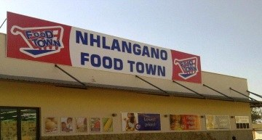
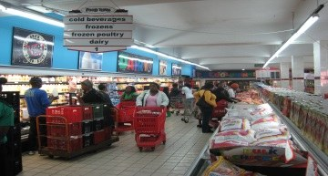
Resurgence of independent retailers?
30-40% of grocery retail market in SA; serve low income consumers (spurred by social grants)
Concerns around decline
But, recent growth of buying groups:
Buy on behalf of many independents
Benefit from economies of scale
Have plans to grow in SA; and to further spread into SADC
Partner with independents: invest in advertising, training, capability development
But still face disadvantageous terms from large suppliers; lack of access to DCs a disadvantage
Cheaper products; convenient locations; personalised service; more responsive to consumer needs; credit facilities
Notes:
Shopping patterns of low-income consumers in townships:
Month start - Shoprite, Boxer, Cambridge etc.
Mid-month - local chain retailer in suburb
Weekly - spazarette or general dealer
Daily - spaza & hawker

Slide 10
Strategic behaviour of supermarkets with market power can create barriers to entry
Anchor tenants in malls enter into leases with property owners with exclusivity clauses
Anchors are a ‘must-have’ for property developers; bring in valuable footfall – market power
Types:
leases with blanket exclusivity clauses or over particular product lines (butchery, bakery etc.)
leases that mandate rival product lines cannot be greater than a stipulated size: e.g. specialist independent butchery cannot be in excess of 300-400m²
Competition Commission SA noted exclusivity lessened competition and created barriers (2009 complaint)
Non-referred due to lack of evidence (high threshold for burden of proof for investigations: substantial lessening or prevention of competition )
Softer measures: advocacy around duration etc. which has not worked
New complaints by SAPOA, Game etc.; CCSA launched retail market inquiry in 2015

Slide 11
Exclusive leases in SA
Insisted upon by supermarkets, not banks - banks care about number and types of lessees
Not favoured by property owners. Prevents landlords from:
placing free-standing bakeries, butcheries or green grocers; excludes independent retailers
optimising best tenant mix suited for shoppers coming to centre; limits expanding centre etc.
Historically highly prevalent; less prevalent in recent year, possibly due to increased competition awareness?
current complaints may be legacy issues in old centres – 10yr leases, renewable
but initial investment often recouped in less than this time
Also a function of size (generally more prevalent in smaller centres <12,500m²)
Function of whether corporate or franchise stores
Still an issue in rural areas for specialised retailers (e.g. Roots Butchery)
Notes:
Shopping centres of 12,000m² can usually only support one anchor tenant; >25,000m² can support two centres of >40,000m² can support up to three supermarkets. Exclusive leases are more likely to be insisted upon when the size of the centre is between 12,000 and 12,500m². Other estimates are that shopping centres between 14,000 and 20,000m²
has led to butchery, Roots, being denied access in malls
Australia: voluntarily undertook to phase out EL, enforceable; new leases no exclusivity
UK: 5 year exclusivity limit

Slide 12
Impact on suppliers
Significant buyer power of supermarkets:
Increasing requirements & private standards imposed on suppliers – Requires capabilities; Supplier Development Programmes to develop capabilities (Massmart SDF)
Able to control trading terms, significant impact on cash flow
Impose various costs (listing fees, slotting fees, advertising & promotion costs, swell allowances etc.)
But large suppliers have some countervailing power; small suppliers most impacted
Supermarkets increasingly investing in private labels/house brands
All major supermarkets have house brands
Suppliers may be ‘forced’ into supplying house brands at lower margins; used as a tool to negotiate down prices for branded products
But, opportunity for small/medium suppliers
An indication of increasing rivalry between supermarkets?
Increased competition from entrants, niche retailers and independents?
Provides an alternative route to market for suppliers
Notes:
Supermarkets are a key route to market for suppliers
Long-term offtake commitments from supermarkets crucial for suppliers to invest and grow
Examples of retailer-led SDPs:
Lethabo Milling, a new entrant producing super maize meal, samp, maize rice, white grits
Entered through Massmart support (Supplier Development Fund from Walmart merger - R240mill)
1.6mn grant by Massmart and R8.2mn loan from ABSA
Massmart provided additional support, e.g. training program, waiving listing fees, fast-track payments, and assisting with pricing model
Cash-flow and working capital management still challenging
Agro-Processing Competitiveness Fund (ACPF): from Pioneer settlement – R250mill; substantial IDC co-funding
Lethabo Milling:
Main competitors: Ace (Tiger), Iwisa (Pioneer)
Total capital of R9.8mn required to refurbish plant and purchase inputs. Comprised of 1.6mn grant by Massmart and R8.2mn loan from ABSA
Took 4 year to obtain funding
Massmart Supplier Development Fund:
Support agricultural projects (Ezemvelo Direct Farm Programme)
Manufacturing (SMME’s programme)
Support services
ACPF: support to non-dominant players
250mill split into Investment, Business support and research grants
Soweto Gold

Slide 13
Conclusion: Is there a role for competition policy?
Barriers and scale economies suggest that there should only be a few large supermarket chains
But new entry of FVC, Choppies & independents has several clear benefits
There is a role for competition policy to level the playing field & reduce barriers to entry:
Stronger ‘enforcement’ on exclusive leases; advocacy not worked in the past in SA; require a revision of the wording in the Act under S8?
Facilitate voluntary and legally enforceable undertakings by incumbent supermarkets (e.g. Australia; UK; Latin America) – through market inquiry
Coordinate with municipalities on open and flexible retail space in urban planning to ensure mix of formats
Level playing field for new entrants/independents by encouraging suppliers to offer them fair prices and terms of supply
Encourage voluntary or stipulate mandatory codes of conduct
Encourage long-term SDPs
Other government efforts?
Govt. funding for DC construction, operations, management etc.
Retail skills training for independent retailers
Notes:
For instance, Pick n Pay in an initiative with Gauteng Department of Economic Development, recently announced that it would open up its distribution channels to township spaza shops, giving them access to stock at competitive pricing.
***Brom (2006) “argues that in many developing countries a private code may well be the most practical and useful approach in the short-to-medium run because it harnesses private sector interest, will, and resources and can be implemented when commercial laws and institutions are still in the development stage. Variants of the Argentine code proved attractive in Latin America, rapidly spreading to Colombia (signed in 2005), Costa Rica (under discussion), and Mexico (signed in June 2006)” Reardon and Gulati, 2008
Manufacturing Competitiveness Enhancement Programme (MCEP)

