Slide 1
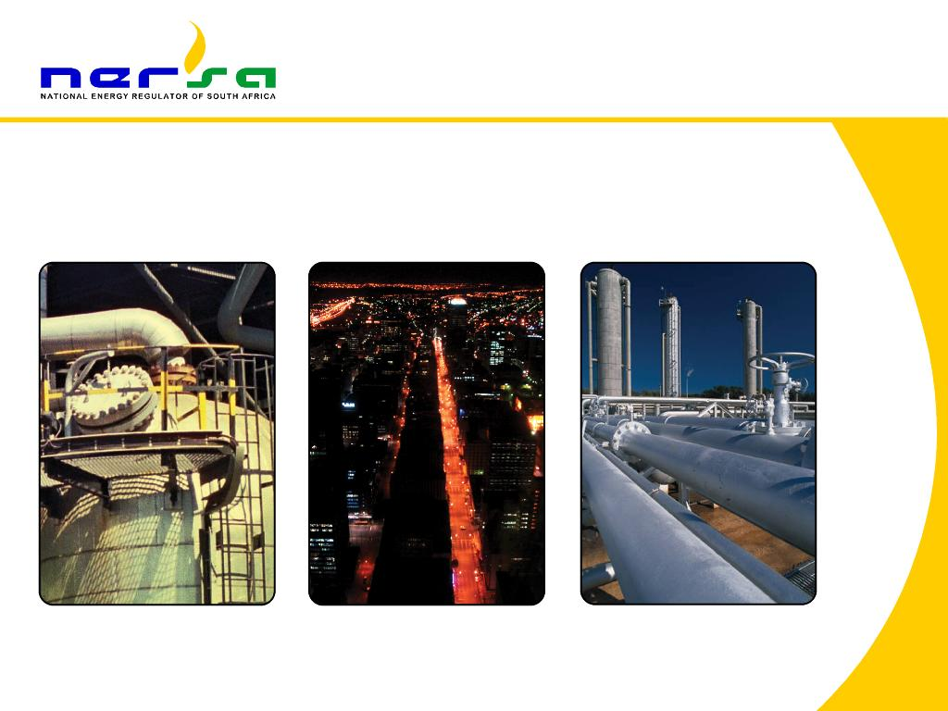
ENHANCING UTILITY EFFICIENCIES THROUGH REGULATION AND COMPETITION
SA Experience in the Gas Industry Regulation
1
Nomfundo Maseti : Regulator Member, NERSA

Slide 2
CONTENT
Introduction
Objectives and Functions ito the Gas Act
Extent of regulation of gas prices
Maximum GE price methodology
Comparison between Maximum Price Levels and Actual Price Levels
Global gas pricing mechanisms

Slide 3
Introduction
The National Energy Regulator of South Africa (NERSA), a Schedule 3A Public Finance Management Act, 1999 (Act No. 1 of 1999) Public Entity was established on 1 October 2005 in terms of the National Energy Regulator Act, 2004 (Act No. 40 of 2004) to regulate:
  Electricity industry (Electricity Regulation Act, 2006 (Act No. 4 of 2006))
  Piped-Gas industry (Gas Act, 2001 (Act No. 48 of 2001))
  Petroleum Pipelines industry (Petroleum Pipelines Act, 2003 (Act No. 60 of 2003))
Prices refer to ‘charges for gas’ (molecule plus trading margin)
Tariffs refer to ‘charges for gas services’ (transmission & Distribution network services)
Therefore: Total price charged to customer: price + tariffs
3

Slide 4
objectives and Functions In terms of the GAS ACT
Objectives of the Gas Act include:
  Development of a competitive gas market and gas services
  Facilitate investment in the gas industry
  Promote access to gas in an affordable manner
Functions include:
  Licensing gas infrastructure (e.g. transmission & Distribution pipelines)
  Approval and monitoring of gas prices and tariffs
  Protection against excessive and discriminatory prices / tariffs
  Facilitate competition through regulating prices and tariffs
  Facilitate access to essential gas infrastructure (third party access)
NB: Regulation and competition may be substitutes, and are both concerned with efficient outcomes
4

Slide 5
Question: How to regulate gas prices in order to promote development of a competitive gas market?
i.e. How to facilitate competition in order to bring about efficient outcomes and financial stability of the utility (privately owned)?
Section 21(1)(p) provides guidance to extent of our regulation and the type of regulation. It provides:
  “…the Energy Regulator must impose licence conditions within the following framework and limitations:
  Maximum prices for distributors, reticulators and all classes of consumers must be approved by the Gas Regulator where there is inadequate competition….”
Limitations – When and How to regulate? NERSA shall intervene only by approving Maximum (NOT Actual prices) prices
When – when NERSA has determined that there is inadequate competition.
5

Slide 6
  No reference to “Effective competition” or “Perfect Competition” or to “Competitive Price level”
So, NERSA must first assess existing market conditions, and if it finds that the state of competition is insufficient, then it can intervene by approving gas prices. Finding of inadequate competition was made.
NEXT Hurdle: How to determine an appropriate Maximum Gas Price Levels that will promote competition and facilitate investment?
Challenge: What should that maximum price level be? The Act does not refer to a Competitive Price level nor does it provide an appropriate benchmark for a maximum price
6

Slide 7
Interpretation issue: Stakeholders contend that the maximum price should be based on marginal cost plus reasonable return
  Reason being that section 21(1)(p) compels NERSA to set a price that represent competition. (Court case arguments)
  What costs or MC is relevant to set the maximum price for the market? (in order to attain competitive and efficient outcome?
  NERSA and stakeholders seem to agree that it cannot be costs of the incumbent monopoly supplier but costs of an alternative supplier (most likely LNG importer)
So, What form of Incentive Regulation did NERSA choose?
Benchmark approach – to approximate the value of gas by reference to weighted average (wholesale) prices of: Coal, Electricity, Diesel, LPG and HFO
7

Slide 8
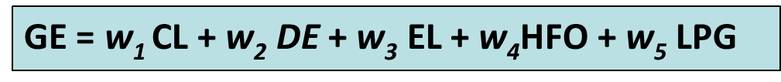
Maximum Gas Energy Price (GE)
  In the absence of a transparent gas market price in South Africa ...
  The GE is determined by reference to energy price indicators
  This is the price of the gas energy at the point of its first entry into the transmission / distribution system
  Based on specific energy price indicators
    Coal (37%), Diesel (27%), Electricity (37%), HFO (1%), LPG (1%)
  Maximum price for GE could also be determined using the pass-through approach
(1) Energy Price Indicators approach (default Benchmark) | (2) Pass-through approach
Maximum price of Gas Energy formula The outcome of the formula depends on the weights attached to the energy indicator prices Weights were determined based on data from an independent source (DoE) and On facts (share of each indicator in secondary energy consumption in SA economy) | The pass-through approach requires a cost-based price build-up Costs include :- the cost of the procured or produced gas, any transportation or re-gasification costs transmission tariffs distribution tariffs, and trading margin determined in accordance with this methodology
8

Slide 9
This methodology refers to
Total price for piped-gas
Trading margin
Margin (R)
Distribution
Tariff (U)
Transmission
Tariff (R)
Maximum price for Gas Energy
Price (R)
9
Notes:
Petroleum Agency South Africa manages the
licensing of oil and gas exploration,
development and production in South Africa and the coastal areas offshore South Africa
DMR is responsible for the mining licensing regime.

Slide 10
What makes up the total price for gas?
Storage tariff (R)
Regasification tariff (U)
Transmission tariff (R)
Distribution tariff (U)
Trading margin (R)
Maximum price for Gas Energy (R)
Maximum price for gas energy approved for individual traders
Other elements added as pass-through costs to determine the total price for gas to customers only where applicable
10
Notes:
Petroleum Agency South Africa manages the
licensing of oil and gas exploration,
development and production in South Africa and the coastal areas offshore South Africa
DMR is responsible for the mining licensing regime.

Slide 11
  The challenge is to find the right maximum price level so that price is not too high or too low, taking into account that there is no adequate competition in the industry
  Objective: determine gas price level that will encourage entry into the gas market, attract investment, ensure financial sustainability of the utility and protect this essential resource from being depleted (perverse outcomes)
  Ideal future outcome: Gas to gas competition resulting in competitive gas markets in South Africa
What tells us the maximum price is at the right level?
Willingness of current customers to buy and prospective customers to switch to gas
Gas price is still low compared to some of the alternatives
11

Slide 12
  Willingness of gas suppliers to supply and attract entry into the market; looking at the economic value of gas
  No critical loss of sales encountered by the incumbent gas supplier and other gas traders
  Affordability of gas – traders buying from the dominant incumbent trader are able to on-sell, and have reported growth and reasonable profit
  Gas traders connected new customers
  New entrants – 3 entrants at the gas trading level in the past 18 months
12

Slide 13
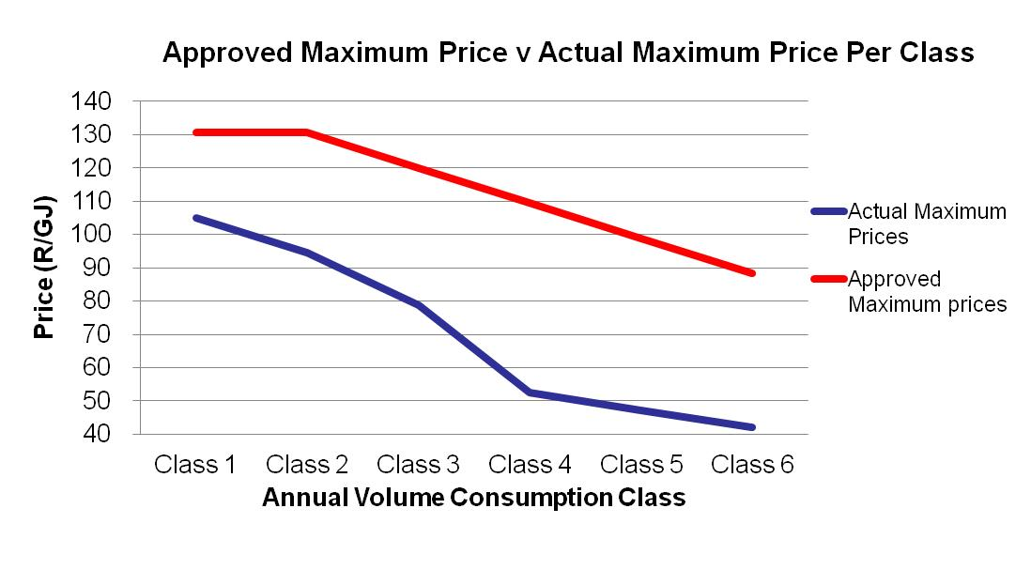
How do Approved Maximum Price Levels Compare to Actual Prices charged?
13

Slide 14
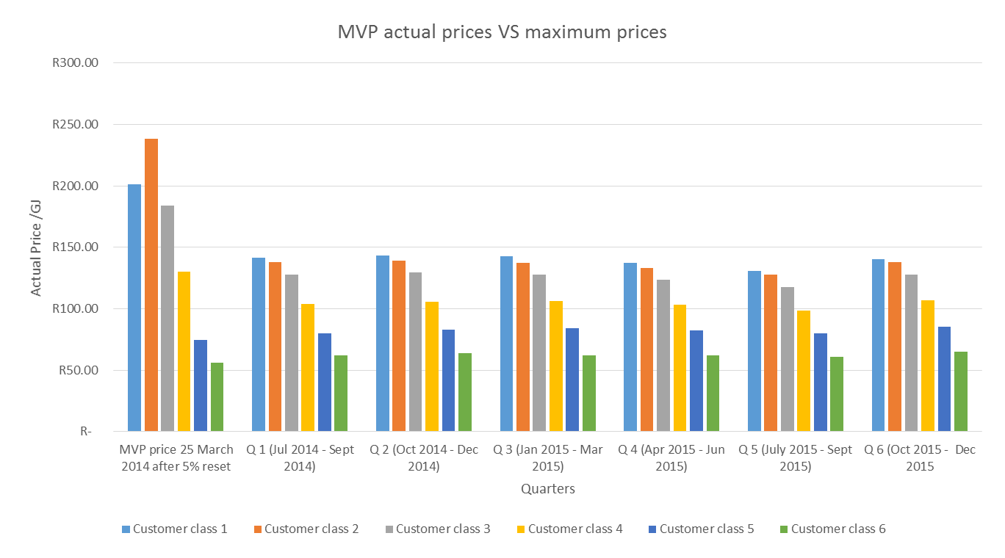
How MVP prices levels compare to Maximum Price Levels per customer class

Slide 15
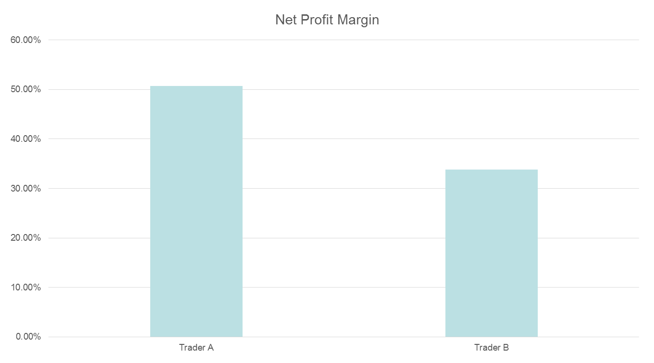
Main Gas Traders Profitability levels

Slide 16
Global gas pricing mechanisms (snapshot)
Pricing in the world gas markets remains fragmented
  The UK and North America have gas-on-gas market pricing mechanism (hub pricing)
  Asia and Asia Pacific remains a predominantly oil-linked LNG market on long-term contracts
  Europe remains a mixture of oil product-linked and hub-priced natural gas market
Spot and short-term LNG trade growing, leading to new contractual arrangements of less than two years vs the traditional long-term contracts
Figure below shows dominant pricing mechanisms in the different regions
Social pricing + Hub pricing + regulated cost of service (RCS)
Hub pricing
(Henry hub dominant)
UK NBP
Oil-indexed
RCS
Social pricing
Hub pricing (mostly spot LNG)
Oil indexed + Hub pricing
Social pricing
Social pricing
Oil-indexed
Hub pricing
OIL-INDEXED
Hub pricing (mostly spot LNG)
Social pricing
Social pricing
Source: International Gas Union, 2015
16

Slide 17
Global gas pricing mechanisms cont.
Hub pricing (gas-on-gas competition) Prices determined according to supply/demand balances at domestic gas trading hubs Gas sold on short-term fixed price and spot prices Long-term contracts also exist but use gas price instead of competing fuel indices | Oil indexation Contract price of gas linked to competing fuels (crude oil, gas oil, fuel oil) Early contracts viewed oil, not natural gas, as the competitive target and thus “price risk” in the escalation clauses was largely defined in oil terms, a pattern that persists even today Contracts typically long-term but short-term contracts also gaining grounds
Regulated cost of service Price determined/approved by a regulatory authority or Ministry Price level set to cover the cost of service including the recovery of investment and a reasonable rate of return | Social pricing Price is set on a political/social basis on an irregular basis to cover increasing cost or as a revenue raising exercise Price is set below the average cost of producing and transporting the gas as a form of government subsidy to the population (subsidy price)
17
Source: International Gas Union, 2015

Slide 18
THANK YOU
Website: www.nersa.org.za
Tel:012- 401 4600
Fax:012- 401 4700
Email: info@nersa.org.za
18

