Slide 1

The Expansion of Regional Supermarket Chains and Implications for Local Suppliers: A case of Zambia
Supermarket Parallel Session
2nd Annual Competition and Economic Regulation (ACER) Week Southern Africa
11th – 12th March, 2016
Livingstone

Slide 2
Outline
Introduction
  Stimulating Industrialisation & Regional Trade
  Study Objectives
Retail Modernisation in Zambia
  Determinants of the Supermarket Wave in Zambia
  Supermarket Landscape in Zambia
Traditional Markets versus Supermarkets
Methodology
Findings and Discussion

Slide 3
Introduction
Liberalisation of Zambian economy in the 1990s – precipitated structural economic changes which attracted and ushered in an influx of Foreign Direct Investments (FDI).
As a result, the past 20 years have seen a sharp increase in the number of supermarkets chain stores across Zambia.
Zambia has experienced rapid economic growth as evidenced by strong GDP growth rates of more than 7% in the last decade
Growth not translated into significant poverty reduction for over 60% of the population.

Slide 4
Introduction
Liberalisation of Zambian economy in the 1990s – precipitated structural economic changes which attracted and ushered in an influx of Foreign Direct Investments (FDI).
As a result, the past 20 years have seen a sharp increase in the number of supermarkets chain stores across Zambia.
However, participation of local suppliers in supermarket value chains remains limited.

Slide 5
Associated with that is the spread of supermarkets which are growing in line with the burgeoning middle class.
Expanding middle class has brought about a spread of supermarkets
Resulting in – increased demand, product availability and provided more choice to consumers

Slide 6
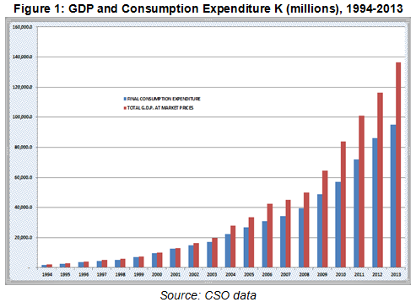

Slide 7
Key Objectives of the Study
The overall objective of this study was to understand the proliferation of regional supermarket chains in Zambia, their business models, procurement strategies and determinants of local suppliers’ participation in their supply chains.
Other Specific Objectives
What are the most dynamic products in terms of processed foods within regional market (which ones offer more opportunities for domestic firms)?
How do business models differ between supermarkets and what is the nature and intensity of competitive rivalry between supermarket chains?
What are the capabilities required for local processing firms to supply food and selected household products to supermarkets and what are the constraints that hinder increased participation?
What is the potential for regional procurement?
What are the existing policies on local content and what enabling policy framework and support mechanisms would be needed in this environment?

Slide 8
Table 1: Major Foreign and Local Supermarkets in Zambia - 2015
Name | Origin | Description | Ownership |  | Total Stores
 |  |  | Corporate | Franchise
Shoprite | South Africa | Supermarket | 26 | 0 | 26
Pick n Pay | South Africa | Supermarket | 12 | 0 | 12
Spar | Netherlands | Supermarket | 8 | 8 | 16
Food Lovers | South Africa | Supermarket | 1 | 1 | 2
Game | South Africa | Supermarket Warehouse | 2 | 0 | 2
Woolworths | South Africa | Supermarket | 2 | 0 | 2
Melissa | Zambia | Supermarket | 3 | 0 | 3
Choppies | Botswana | Supermarket | 1 | 0 | 1

Slide 9
Zambia’s Supermarket strategic analysis
Shoprite (1995)
26 corporate stores spread around the country
Largest retailer – foodstuffs and household items
Employs 5000 people
Cost leadership
  low cost producer
  Pursues economies of scale
  Preferential access to raw materials
Spar (2003)
16 stores ( 8 Corporate and 8 franchise)
Foodstuffs and household items
Cost leadership

Slide 10
Zambia’s Supermarket strategic analysis Cont.
Pick n Pay (2010)
11 corporate stores
Foodstuffs and household items
Employs in excess of 2000
Cost focus strategy - Cost advantage in target segments and narrow competitive scope
Game Stores (1999)
2 corporate stores
General merchandise, electrical appliances, non perishable goods and other foodstuffs
Focused differentiation strategy - seeks to be unique in target industry
Others – Fruit and Veg City (FVC), Woolworths and Melissa

Slide 11
Sample and Data Collection
Primary data collection method – Survey of local procession firms using a structured questionnaire
Suppliers to Supermarkets – Treatment group
Non-Suppliers – Control group
Total of 98 firms were surveyed
- 48% recorded as supermarket suppliers - 52% recorded as non-suppliers
Sample spread (Lusaka - 48% of firms, Copperbelt – 28%, Southern and Eastern Province – 13% each)

Slide 12
Findings and Discussion..

Slide 13
Quick Characteristics of Sample
Understanding the distribution of firms by business size is necessary to appreciate how firm size influences their ability to acquire or have the rights skills, technology and capital to investment in better production techniques that allows them to supply supermarkets.
According to the MSME Development Policy, MSMEs are classified according to the size of total fixed investments, sales turnover, number of employees or legal status.
For the purposes of this study, the number of employees is used to classify firms because this variable attained a higher response rate
Over 50% of those supplying supermarkets were medium to large compared to 26% of those supplying traditional markets

Slide 14
Distribution of Firm Ownership
For the purpose of this study firm ownership was defined as having shares above 50% share
Of the sample, 60% of those supplying to supermarkets were Zambian owned
40% managed by Non-Zambians
Amongst the non-suppliers, this ratio was evenly split with 52% belonging to Zambian and 48% in foreign hands
Gender involvement - for both suppliers and non-suppliers women involvement was about 30%

Slide 15
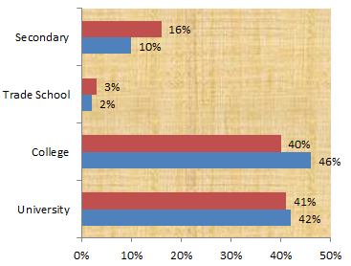
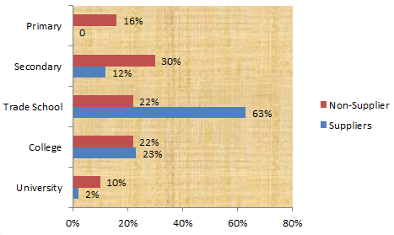
Supplier’s Educational Levels
Management Staff
Technical Staff

Slide 16
Proportion of Suppliers and Non-Suppliers with ZABS requirements
Under the Zambia Standards Act 1994 - mandatory requirement for all food and beverage suppliers to have a permit to supply
ZABS also provide certification for products - voluntary requirement and it only assures the customer that the certified product is periodically inspected and tested and conforms to the required standards.
Do ZABS standards influence participation?
For supermarket suppliers, 73% of those interviewed possessed both a permit to supply and a ZABS certification compared to the 48% among non-suppliers
This could indicate that a permit to supply increases the chances for participation in the supermarket value chain

Slide 17
Reasons for Not Supply Supermarkets - (Non-Suppliers)

Slide 18
Other Constraints or costs associated with supplying supermarkets
In addition to the legal and regulatory requirements, firms cited the following as additional private standards demanded by supermarkets:
- Barcodes
- high quality packaging
- merchandisers
- supplying all stores country-wide
- using own distribution transportation
49% of the firms said they incur additional costs in trying to meet these standards which is
32% of firms both suppliers and non-suppliers felt having merchandisers was a constraint as this added to their overall wage bill
Barcodes as an Exclusion Restriction?
d. Does your firm have barcodes for all main products supplied to supermarkets or that you would like to supply to supermarkets? | a. Do you supply supermarkets? |  | Total
 | Yes | No
Yes | 37 | 13 | 50
No | 10 | 33 | 43
Total | 48 | 46 | 93

Slide 19
Although many firms cited barcodes as one of the private standards required by supermarket, 17% of supermarket suppliers did not have barcodes for the products supplied to supermarkets.
The possession of a barcode may therefore not be appropriate as an exclusion restriction for the simple reason that firms without barcodes are still able to supply supermarkets.
However, it is noted that the majority of firms, about 66.7% not supplying supermarkets do not have barcodes which suggests that barcodes could be a determinant of participation for certain product lines

Slide 20
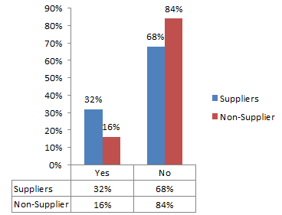
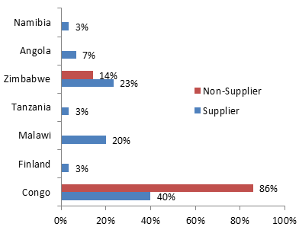
Export Capabilities for Local Suppliers

Slide 21
Export Capabilities Contd….
In our Survey, 32% of supermarket suppliers and 16% of non-suppliers have integrated themselves into export market.
The figure also shows potential export markets albeit “cumbersome” border procedures
The Congolese effect – Congo seem to provide an attractive informal market for non-suppliers
Recent trade agreements could offer opportunities for local suppliers to enter into regional markets.

Slide 22
    Dynamic Processed Goods: What Products Offer Opportunities for Local Firms?
Dynamic products sold by supermarkets measured by the volume of sales include: fresh milk, Maize meal, corned meat, cooking oil and detergent paste
Canned products purportedly offer domestic firms most opportunities for increased local production due to low local production
Opportunities still abound in household consumables such as detergents, bathing soaps and other cleaning agents.
Top 3 Products Sold by Supermarket for each Product Category (by sales volumes)
Dairy | Processed Grains | Processed Foods | Edible Oils | Household Products
Fresh Milk | Maize Meal | Baked Beans | Cooking Oil | Detergent Paste
Lacto | Bread | Corned Meat | Margarine Butter | Bathing Soaps
Yoghurts | Rice | Honey | Olive Oil | Dish Washer

Slide 23
    Supermarkets’ Procurement Strategy: Strategic Barriers to Entry?
The level at which procurement decisions are made presents challenges for local suppliers.
Store managers do not have discretion in selecting local suppliers for corporate store - almost exclusively the decision of top management at head office and often with input from the group head office.
Supermarkets operating as franchises have more flexibility with regard to making decisions on which firms should supply their store.
While their decisions are sometimes influenced by the head office, they make their own decisions regarding which local firms will supply them.
This suggests that it is relatively easier to enter supermarket value chains of franchise stores than corporate stores.

Slide 24
Supermarket Procurement Criteria: Exclusionary Barriers
Processed products, particularly food products need to meet the minimum food and safety standards to ensure public health protection such as those stipulated by the Zambia Bureau of Standards (ZABS), Zambia Environmental Management Agency (ZEMA), the Medicines Act and the Sale of Goods Act etc.
These legal requirements in themselves present regulatory barriers to entry for local suppliers
But in addition, additional supermarket private standards, not mandatory by law, may act to further exclude some domestic firms from supplying supermarket value chains.
Supermarkets demand local firms to meet the following requirements: a marketing budget for the promotion of the firm’s goods; merchandisers to man the firm’s shelf space in the store; firm’s own transport logistics when supplying goods; and for some supermarkets, ability to supply a certain minimum number of stores with the exception of firms producing niche products.
These demands impose additional costs on suppliers and thus require additional capital injections

Slide 25
Supermarket Procurement Criteria: Exclusionary Barriers
A divergence exists between the importance supermarkets attach to a number of factors that determine their procurement decisions and their perception of the capabilities of local suppliers to meet these factors (see figures below)
Supermarkets demand higher standards than that met by local suppliers
Using a scale of 1 to 5, supermarkets self-ranked the importance of price, quality, volumes, lead times, distance to supermarkets, conditions of processing plants, consistency, packaging and innovation in influencing their decision to procure dairy, processed grains and foods, edible oils and household products
On average, utmost importance is attached to the quality, volume supplied, lead times, packaging and condition of the processing plant for dairy, processed grains and foods, edible oils and household consumables.
Consistent and pricing of goods supplied is also a decisive factor albeit to a lesser extent

Slide 26
Supermarkets’ Procurement Criteria
Supermarkets' Perception of Local Suppliers' Capabilities

Slide 27
    Support Rendered to Local Suppliers
To a large extent, supermarkets relaxed their strict standards for processed goods in order to grant more local suppliers access to supermarket stores
To facilitate procurement, supermarkets further developed a system for ordering and supply that incorporates local suppliers
Other support comes in the form of the provision of:
information to local suppliers on the standards required to supply supermarkets
Providing local suppliers contacts for institutions that certify products in Zambia
Highlight success stories of the growth of local suppliers supplying supermarkets through the media to encourage more local suppliers to supply supermarkets.
These measures suggest a lowering of barriers to entry.

Slide 28
    Competition from Growing Vertical Integration
Growing production of supermarket’s own private label brands provides rivalry to locally produced goods
Over the years, supermarkets have ventured into the production, distribution and retail of various products such as processed foods and household products under their supermarket brand
Some products are manufactured by locally but the bulk is made in South Africa and other countries
Extension of the operations of supermarkets to include production, distribution and marketing creates vertical integration linkages which have the potential to exclude goods produced by domestic firms
Market access to supermarket stores is guaranteed for supermarket private brands
In order to promote their own manufactured products, supermarkets could raise barriers to entry for locally produced goods by imposing more stringent requirements of supply and thus the exclusion of local firms
Conversely, the development of supermarket private brands presents opportunities for the manufacture of these products domestically
Domestic firms can be contracted by supermarkets to produce private branded goods for supermarkets.

Slide 29
    Competitive dynamics: Supermarkets versus Supermarkets
Entry of more supermarkets in Zambia has prompted incumbent supermarkets to tighten their price strategy and their marketing expenditure in response to the new competition
Some supermarkets use exclusive leases with shopping centres to curtail competition.
One supermarket attested to having an exclusive lease with the shopping mall for the purpose of being an anchor tenant and the main attraction of customers
Duration of this exclusive lease was said to be 5 years.
In contrast, another supermarket denied having an exclusive lease agreement with shopping malls but admitted to their existence previously
Such leases were traditionally long term of 25 to 30 years but were no longer in effect as a result of the Consumer Protection Commission (CCPC) Act which discouraged exclusivity clauses.
Notably, none of the supermarkets reported to have been denied access to a shopping mall as a result of an exclusive lease in place between a major incumbent supermarket and the shopping mall.

Slide 30
Thank You All

