Slide 1
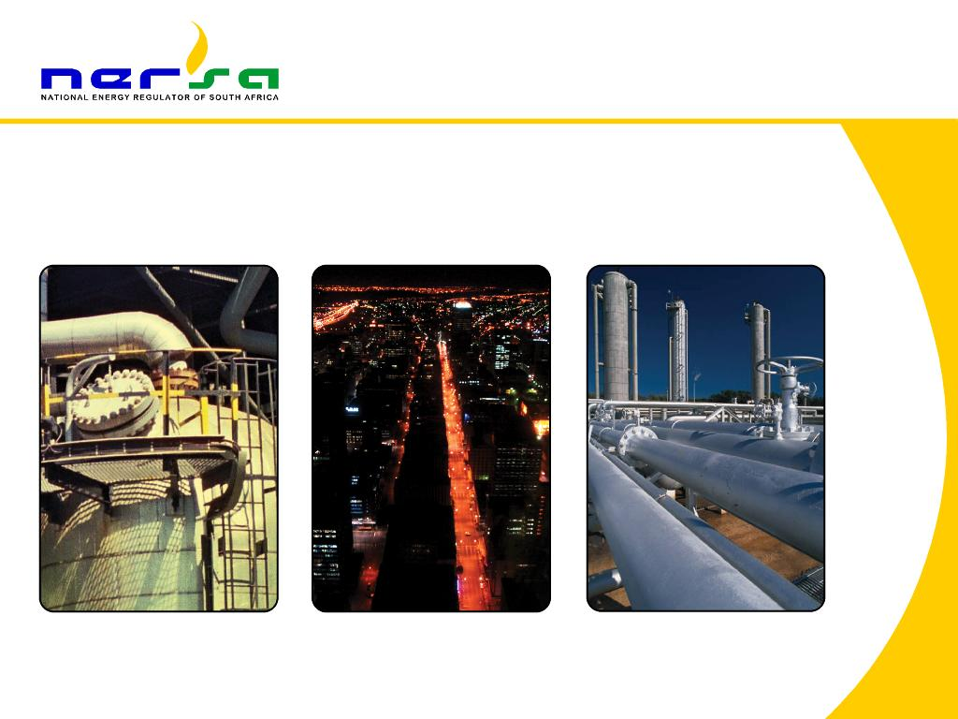
2nd ACER CONFERENCE
THE TRADE-OFFS BETWEEN PRO-POOR AND COST-REFLECTIVE TARIFFS IN SOUTH AFRICA: A REGULATORY PERSPECTIVE
Michael Maphosa and Patrick Mabuza

Slide 2
Outline
Introduction
Why this study
Rationale for Pro-poor tariffs
Rationale for cost-reflective tariffs
Key challenges: achieving pro-poor and cost reflective tariffs
The role economic regulator
Competing expectations: utilities vs. poor customers
Recommendations

Slide 3
Introduction
Tariffs have always been an unfailing annoyance to utilities and customers alike
There have never been a lack of interest in the subject of electricity tariffs. Like all charges upon the consumer, they are an unfailing source of annoyance to those who pay, and of argument to those who levy.
Appropriate tariffs are necessary for develop: There is a general agreement that appropriate tariffs are essential to any rapid development of electricity supply however, there is complete disagreement as to what constitutes an appropriate tariff.
In south Africa, the structure of existing tariffs for residential customers does not reflect the underlying costs.
Tariffs for industrial and commercial customers already embody cost-reflective pricing principles
The ESI has a host of cross-subsidies aimed at achieving affordability and access.
2

Slide 4
Why this study
Conflicting objectives: cost reflectivity of tariffs and pro-poor policy objectives.
Increase in the number of people struggling to afford electricity.
Utilities financial sustainability endangered.
Low level of investment in the industry due to low tariffs.
Global movement towards cost reflective tariffs.
3

Slide 5
Rationale for pro-poor tariffs
Pro-poor policies are concerned with access to affordable electricity services.
One way of proving electricity to the poor households is through subsidies.
Although subsidies are seen as the only solution, it has its on challenges
Subsidies are a burden to the subsidising population and questions are being asked:
Why do subsidising customers carry the burden
Are poor households not over-subsidised?
What is the appropriate grade of service that a subsidy to the poor should seek to achieve?
Is it permissible to allow utilities to offer a low-grade service at a lower price to allow the poor to receive at least a service. Thus giving the poor options that make services more affordable while at the same time reducing the subsidy burden to the subsidising group?
Regulators and policy makers are still grappling with this issue.
Those that support providing a low grade service argue that providing a high-grade level of service is not what the poor need-what they need is a level of service that is affordable and meets their needs.
4

Slide 6
Extent of cross subsidisation
 | Allocated allowed costs | Current tariffs | Current subsidy | Current subsidy (% of revenues)
Total | R12.2 | R7.6 | -R4.5 | -59%
Homepower | R 2.4 | R 2.1 | -R 0.3 | -15%
Homelight 20A | R 5.3 | R 2.6 | -R 2.7 | -107%
Homelight 60A | R 4.5 | R 2.9 | -R 1.5 | -49%
Subsidies 2012/2013 FY (billion)
Source: Eskom (2013)
5

Slide 7
Rationale for cost-reflectivity
Critical for improving sustainability of utilities and reducing costly subsidies.
Three important reasons why tariffs should be linked to actual cost drivers
It promotes efficient use of electricity infrastructure
It promotes efficient investment in electricity infrastructure and innovative technology
Fair pricing system as consumers directly contribute to the costs that they impose on the system because of their usage.
The overarching argument in cost reflectivity is that where end consumers are faced with the actual costs of their consumption and decide to change their behaviour, network investment can be avoided and costs sustainably reduced.
Therefore it has become obvious that without cost-reflective tariffs, private and public utilities would find it difficult to raise capital to expand their electricity infrastructure.
6

Slide 8
Tariffs vs. Costs
Although cost-reflectivity is important for the ESI, achieving cost-reflective tariffs in a heavily subsidised environment may negatively affect pro-poor government policies
7
Source: Eskom, 2013

Slide 9
Key challenges in achieving pro-poor and cost reflective tariffs
High percentage of low-income customers in need of subsidies.
Low number of subsidising customers.
Over burden on subsidising customers
Cost reflective tariffs are often beyond the reach of poor customers.
Ideally, tariffs should be cost reflective across all customer classes.
Is it possible to achieve cost reflectivity in developing economies given the above challenges and what are the implications for the poor?.
Subsidy receipts and contributions per sector
Source: Eskom cost allocation based on MYPD3 2014/15 tariff decision
8

Slide 10
Competing expectations: utilities vs poor customers
Consumers and utilities have different expectations which at times regulatory authorities find difficult to balance. Utilities want to recover their full cost of supplying electricity while poor customers are concerned with access and affordability
Utilities | Poor customers
Risk mitigation | Dependable service at a fair and reasonable price.
Costs recovery | Reliable and safe supply
Reasonable return on investment | Protection from exploitation by operators
Financial balance: Costs and Tariffs | Participation, consultation, and transparent decision making.
Regulatory certainty | Prompt response to customer complaints and disputes
Customer buy-in | Simplicity, convenience of payment and understandability.
9

Slide 11
The role of economic regulators
The main challenge of economic regulation in these changing times is and still remains regulating the sector in a manner that balances competing conditions such as;
Poverty vs. Affordability
Balancing private and public interest
Infrastructure imbalance and Political Economy
Necessity vs. Being Popular
Economic regulators must take into account cost recovery, signals for investors, efficient use of the network, simplicity and cost-effectiveness, transparency, and social and political objectives among others.
The choice is hard but in a developing country, economic Regulators must hold a long term perspective and be guided by principal positions while making such hard decisions.
10

Slide 12
Recommendations
Gradual move towards cost-reflectivity in order to minimise the impact.
An understating of the level of service grade the poor need based on their economic circumstances.
An understanding of other subsidies that accrue to the poor.
Over-subsidisation of the poor can delay the achievement of cost-reflective tariffs.
Indicators should be developed that will assist policy makers and regulators in determining whether the poor still need subsidies or are able to pay for the full service
Monitoring tools to determine whether high-income households receive subsidies or not
Utilities must develop strategies to include poor households.
Lobby groups should b established to ensure that the previously unserved constituencies receive basic services that reflect their economic circumstances.
11

Slide 13
Thank You!
Michael.Maphosa@nersa.org.za
+27 401 4699
12

